Slide 1
AI-Powered Multi-Scan Medical Imaging and Report Interpretation System
CSE7302- University Project
Review-1
Batch Number: CSE_115
Under the Supervision of,
Mr. Praveen Giridhar Pawaskar
Assistant Professor
School of Computer Science and Engineering
Presidency University
Roll Number | Student Name
20211CSE0242 | Zoya Alam
20221CSE0021 | Faizan Ahmed
20221CSE0048 | Siddique Ali Khan
Name of the Program: Computer Science & Engineering
Name of the HoD: Dr. Blessed Prince
Name of the Program Project Coordinator: Mr. Muthuraju V.
Name of the School Project Coordinators: Dr. Sampath A K , Dr. Geetha A

Slide 2
Problem Statement Number: SIH25131
Organization: AICTE - MedTech / Biotech / HealthTech
Category (Hardware / Software / Both) : Software
Problem Description:
Healthcare facilities rely on medical scans and lab reports for patient care, but many centers, especially in rural and semi-urban areas, lack continuous access to radiologists, causing delays in reviewing X-rays, MRIs, ultrasounds, skin images, and lab reports, while patients receive little understandable explanation of results, making it hard to judge urgency or next steps, which leads to late diagnosis, poor triage, overcrowding of tertiary hospitals, and unequal access to basic healthcare information.

Slide 3
Content
Problem Statement
Objectives
Background and Related work for title Selection
Analysis of Problem Statement
Background and Related Work
Innovation or Novel Contributions
GitHub Link
Timeline of the Project
References

Slide 4
Analysis of Problem Statement
Problem Statement:
Many healthcare centers, especially in rural and semi-urban areas, lack round-the-clock access to radiologists, causing delays in interpreting medical scans and lab reports, low patient understanding of results, weak triage, late diagnosis, and overcrowding of higher-level hospitals.
Objectives
Develop a cloud-based system to support interpretation of multiple medical scan types and lab reports.
Provide non-diagnostic, patient-friendly explanations of scan findings.
Classify cases into urgency levels to support triage.
Enable secure storage and controlled access to medical data.
Integrate hospital location support for patient referral.

Slide 5
Analysis of Problem Statement
Technology Stack Components:
Component | Technology
Frontend | React + TypeScript
Backend | Node.js + TypeScript
AI Engine | Gemini (Vision + LLM)
Database | Firestore
File Storage | Firebase Auth
Authentication | Firebase Auth
Maps | Google Maps API

Slide 6
Background and Related Work:
Existing Research
AI models generate radiology reports from X-ray, MRI, and CT images.
Vision-language models convert scans into readable medical text.
Most systems focus on report generation accuracy, not on what happens after the report.
Many studies are limited to research settings and not built as full user platforms.
Limitations Found
Existing systems stop at report generation and do not help with urgency or triage.
Reports are written in technical language and are hard for patients to understand.
No clear support for guiding patients on what to do next.
Poor integration with hospital workflow and patient access.

Slide 7
Innovation / Novel Contributions:
Novelty
ScanWise extends AI-based report generation by adding triage intelligence, patient-friendly explanation, and next-step guidance in a single cloud-based software platform.
Key Contributions
Converts AI scan analysis into urgency levels (Emergency / Priority / Routine).
Generates simple, non-diagnostic explanations for patients.
Provides next-step guidance instead of only raw reports.
Supports multiple scan types in one system.
Works as a software-only, cloud-based solution.
Why Innovative?
Moves beyond report generation to decision support.
Focuses on action, not just text.
Designed for high-load hospitals and rural clinics.
Bridges the gap between AI output and real-world use.

Slide 8
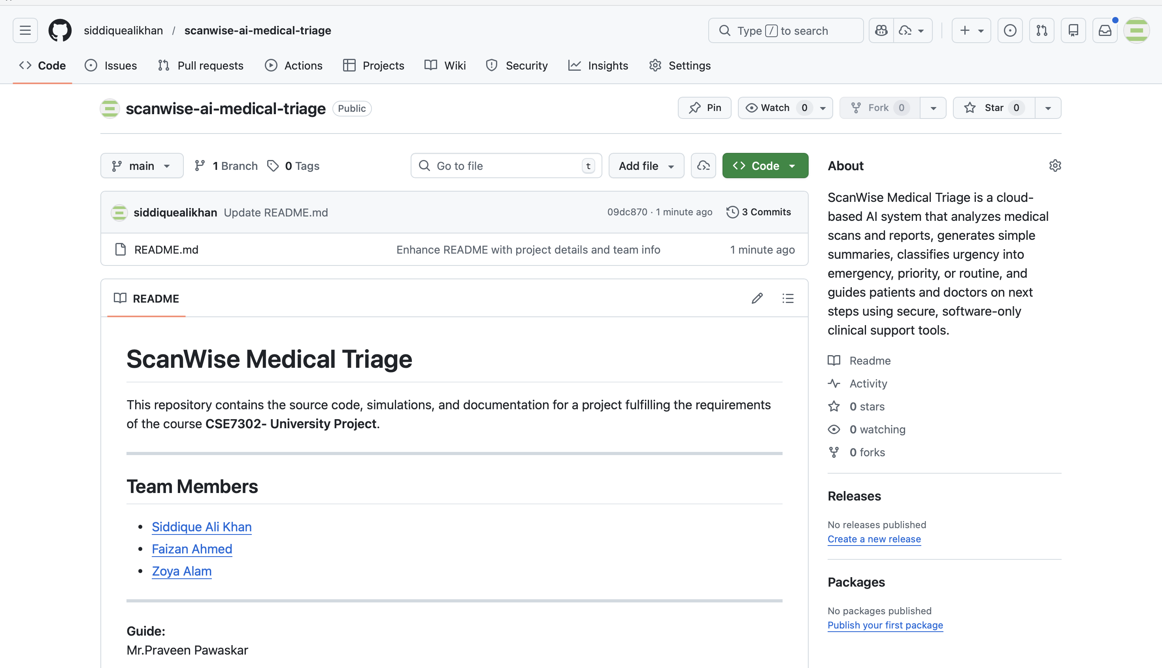
GitHub Link
Repository Name: scanwise-ai-medical-triage
Public Link: https://github.com/siddiquealikhan/scanwise-ai-medical-triage

Slide 9
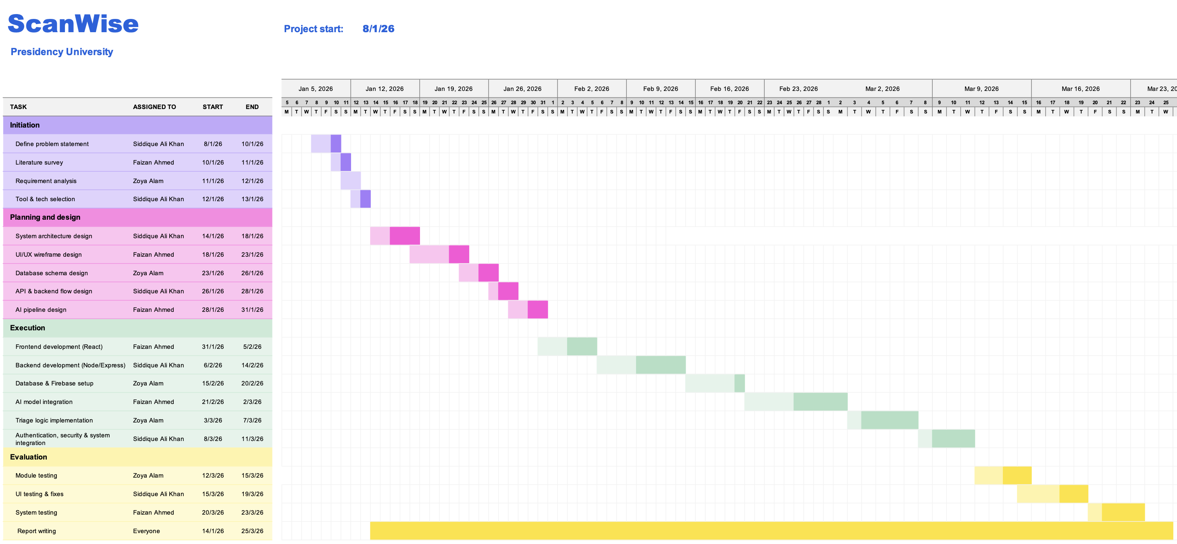
Timeline of the Project (Gantt Chart)

Slide 10
References (IEEE format)
[1] J. O. Lee, H. Y. Zhou, T. M. Berzin, D. K. Sodickson, and P. Rajpurkar, “Multimodal generative AI for interpreting 3D medical images and videos,” NPJ Digital Medicine, vol. 8, no. 1, p. 273, May 2025, doi: 10.1038/s41746-025-01649-4.
[2] A. Hosseini, A. Ibrahim, and A. Serag, “M3: Multimodal artificial intelligence for medical report generation and visual question answering from 3D abdominal CT scans,” BJR | Artificial Intelligence, vol. 2, no. 1, Jan. 2025, Art. no. ubaf011, doi: 10.1093/bjrai/ubaf011.
[3] Z. Yao, F. Lin, S. Chai, W. He, L. Dai, and X. Fei, “Integrating medical imaging and clinical reports using multimodal deep learning for advanced disease analysis,” arXiv:2405.17459, 2024. Available: https://arxiv.org/abs/2405.17459
[4] D. Mamdouh, M. Attia, M. Osama, N. Mohamed, A. Lotfy, T. Arafa, E. A. Rashed, and G. Khoriba, “Advancements in radiology report generation: A comprehensive analysis,” Bioengineering, vol. 12, no. 7, p. 693, Jun. 2025, doi: 10.3390/bioengineering12070693.
[5] P. Rajpurkar et al., “CheXNet: Radiologist-Level Pneumonia Detection on Chest X-Rays with Deep Learning,” arXiv preprint arXiv:1711.05225, 2017.

Slide 11
References (IEEE format)
[6] A. Esteva et al., “Dermatologist-Level Classification of Skin Cancer with Deep Neural Networks,” Nature, vol. 542, no. 7639, pp. 115–118, Jan. 2017.
[7] G. Litjens et al., “A Survey on Deep Learning in Medical Image Analysis,” Medical Image Analysis, vol. 42, pp. 60–88, Dec. 2017.
[8] J. D. Zech et al., “Variable Generalization Performance of a Deep Learning Model to Detect Pneumonia in Chest Radiographs,” PLoS Medicine, vol. 15, no. 11, Nov. 2018.
[9] World Health Organization, “Ethics and Governance of Artificial Intelligence for Health,” WHO Press, Geneva, Switzerland, 2021.
[10] E. J. Topol, “High-Performance Medicine: The Convergence of Human and Artificial Intelligence,” Nature Medicine, vol. 25, no. 1, pp. 44–56, Jan. 2019.

Slide 12


